Slide 1
CheXNet: Radiologist-Level Pneumonia Detection on Chest X-Rays with Deep Learning
Group - F

Slide 2

Table of Contents
01
02
03
Introduction
About the disease
About model, dataset and accuracy metric
Methodology
Training
Test
Results and Findings
Limitations
Advantages

Slide 3
Authors
Pranav Rajpurkar
Jeremy Irvin
Kaylie Zhu
Brandon Yang
Hershel Mehta
Tony Duan
Daisy Ding
Aarti Bagul
Robyn L. Ball
Curtis Langlotz
Katie Shpanskaya
Matthew P. Lungren
Andrew Y. Ng

Slide 4
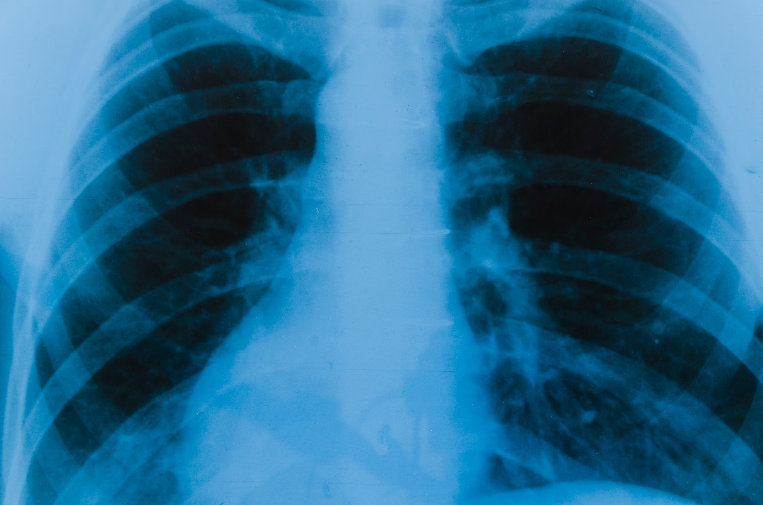
Introduction
Pneumonia is diagnosed using Chest X-ray.
CheXNet: A 121-layer convolutional neural network.
Inputs: Chest X-ray image
Outputs: Probability of pneumonia along with a heatmap.
Compared with a test set of four radiologist annotations via F1 metrics.
Successfully extended to detect the other 14 diseases.

Slide 5
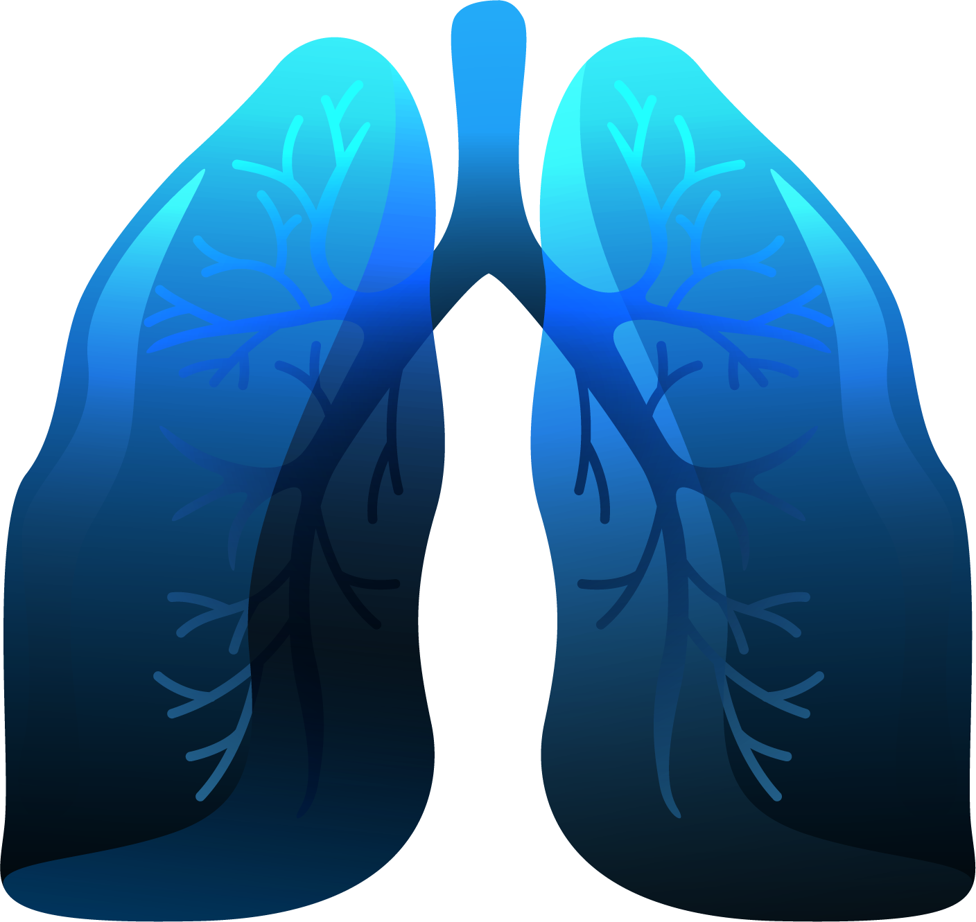
About Pneumonia
More than 1 million adults are hospitalized with pneumonia.
Around 50,000 die from the disease every year in the US alone.
Chest X-ray: Currently the best available method for diagnosing pneumonia.
Pneumonia detection via chest X-rays heavily relies on the availability of experts.

Slide 6
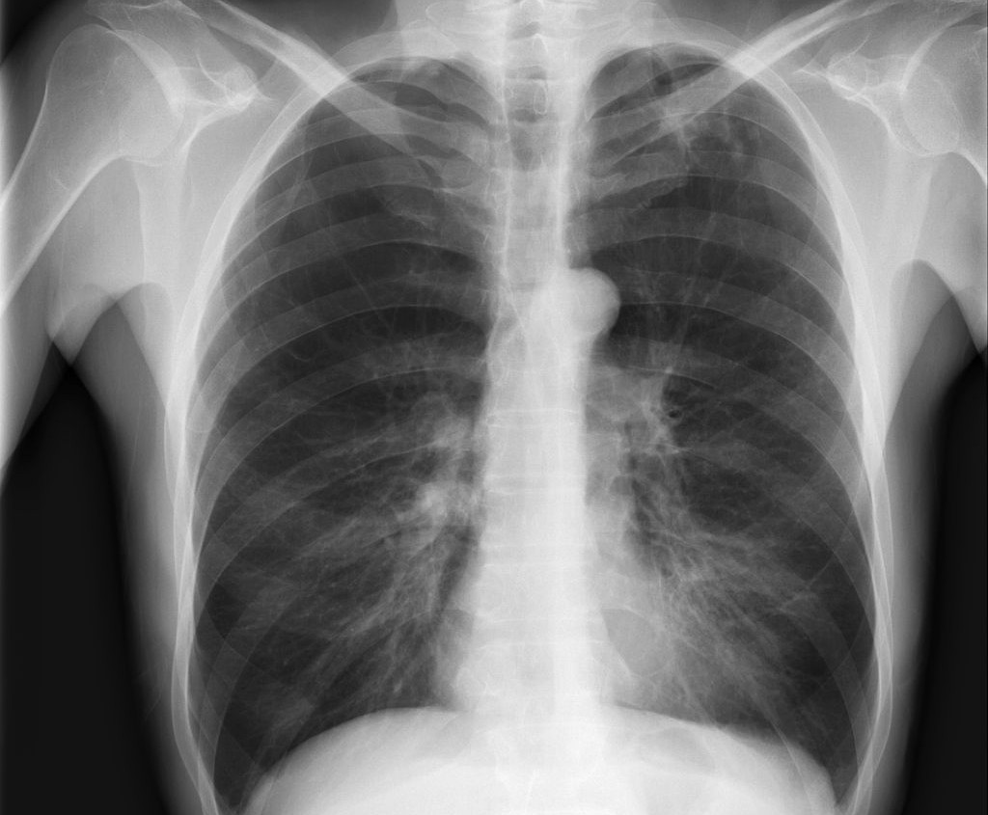
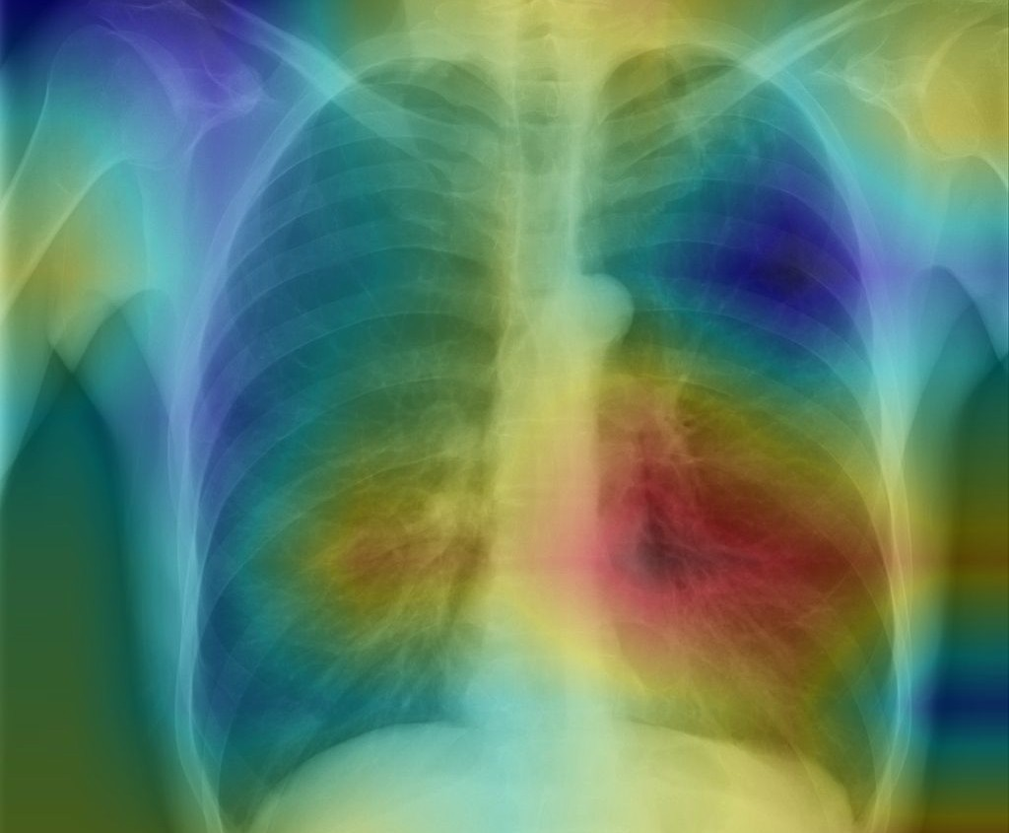
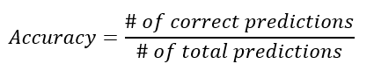
About the Model, Data Set and Accuracy Metric
Input Chest X-Ray Image
CheXNet 121-layer CNN
Output Pneumonia Positive (85%)
CheXNet
ChestX-ray14
F1 Score
A 121-layer dense convolutional neural network
Largest publicly available chest X-ray dataset.
Containing over 112,120 frontal view X-ray images with 14 diseases.
Preferred acuracy metric.
 | F1 Score (95% CI)
Radiologist 1 | 0.383 (0.309, 0.453)
Radiologist 2 | 0.356 (0.282, 0.428)
Radiologist 3 | 0.365 (0.291, 0.435)
Radiologist 4 | 0.442 (0.390, 0.492)
Radiologist Avg. | 0.387 (0.330, 0.442)
CheXNet | 0.435 (0.387, 0.481)

Slide 7
Methodology
DenseNet’s improved flow of information and gradients through the network makes it ideal for this project.
The final fully connected layer is replaced with one that has a single output.
After which a sigmoid nonlinearity is applied.
01
02
03
04
The weights of the network are initialized with weights from a model pretrained on ImageNet
The network is trained end-to-end using Adam with standard parameters.
(β1 = 0.9 and β2 = 0.999)

Slide 8
Training
Downscale the images to 224×224 and normalize based on the mean and standard deviation of images in the ImageNet training set.
Label the images with pneumonia as positive otherwise negative.
01
02
03
04
Randomly split the dataset into training, validation and test.
(No patient overlapping)
Augment the training data using random horizontal flipping.

Slide 9
Test
420 frontal X-ray samples were collected.
The same samples were fed to the network model.
Annotations were obtained independently from four practicing radiologists.
Output accuracy was cross examined with the annotations.

Slide 10
Figure: CheXNet localizes pathologies it identifies using Class Activation Maps, which highlight the areas of the X-ray that are most important for making a particular pathology classification. The captions for each image are provided by one of the practicing radiologists.

Slide 11
Results and Findings
Pathology | Wang et al. (2017) | Yao et al. (2017) | CheXNet (ours)
Atelectasis | 0.716 | 0.772 | 0.8094
Cardiomegaly | 0.807 | 0.904 | 0.9248
Effusion | 0.784 | 0.859 | 0.8638
Infiltration | 0.609 | 0.695 | 0.7345
Mass | 0.706 | 0.792 | 0.8676
Nodule | 0.671 | 0.717 | 0.7802
Pneumonia | 0.633 | 0.713 | 0.7680
Pneumothorax | 0.806 | 0.841 | 0.8887
Consolidation | 0.708 | 0.788 | 0.7901
Edema | 0.835 | 0.882 | 0.8878
Emphysema | 0.815 | 0.829 | 0.9371
Fibrosis | 0.769 | 0.767 | 0.8047
Pleural Thickening | 0.708 | 0.765 | 0.8062
Hernia | 0.767 | 0.914 | 0.9164
 | F1 Score (95% CI)
Radiologist 1 | 0.383 (0.309, 0.453)
Radiologist 2 | 0.356 (0.282, 0.428)
Radiologist 3 | 0.365 (0.291, 0.435)
Radiologist 4 | 0.442 (0.390, 0.492)
Radiologist Avg. | 0.387 (0.330, 0.442)
CheXNet | 0.435 (0.387, 0.481)
Table 2. CheXNet outperforms the best published results on all 14 pathologies in the ChestX-ray14 dataset. In detecting Mass, Nodule, Pneumonia, and Emphysema, CheXNet has a margin of >0.05 AUROC over previous state of the art results.

Slide 12
Limitations and Advantages
Limitations
Advantages
Only front view X-rays are accepted in the model.
Up to 15% accurate diagnoses require the lateral view.
The radiologists were not permitted to use patient history, which has been shown to improve diagnostic performance.
Diagnose pneumonia in absence of a physician.
Can be used as a secondary helping tool on further experiments and diagnosis.
Very effective in the event of an epidemic.

Slide 13
Thanks
Do you have any questions?
Please keep this slide for attribution

